Slide 1
Predicting Customer Churn in Telecommunication Industry
Candidate:
Syed Haider Ali
Supervisor:
Hamidreza Khaleghzadeh

Slide 2
Agenda
Introduction
Previous Work
Methodology
Patterns in dataset
Modeling
Conclusion

Slide 3


Introduction
What is customer churn?
Telecommunication industries spending on solutions that predict customer churn.
Provide promotions and offers

Slide 4
Previous work
Wide range of machine learning models (single, ensemble, etc.)
Fundamental steps
Correct data preprocessing steps
Correct ML model
Top scoring performance models
Sr. | Model | Accuracy | Model
1 | (Edwine et al., 2022) | 99% | Random Forest + GS
2 | (Wagh & Wagh, 2022) | 99% | Random Forest
3 | (Ly, T. V., & Son, 2022) | 98.9% | Support Vector Machines
4 | (Jain et al. 2022) | 97% | Gradient Boosted Trees
5 | (Zhang et al., 2022) | 93.94% | Logistic Regression

Slide 5
Methodology

Slide 6
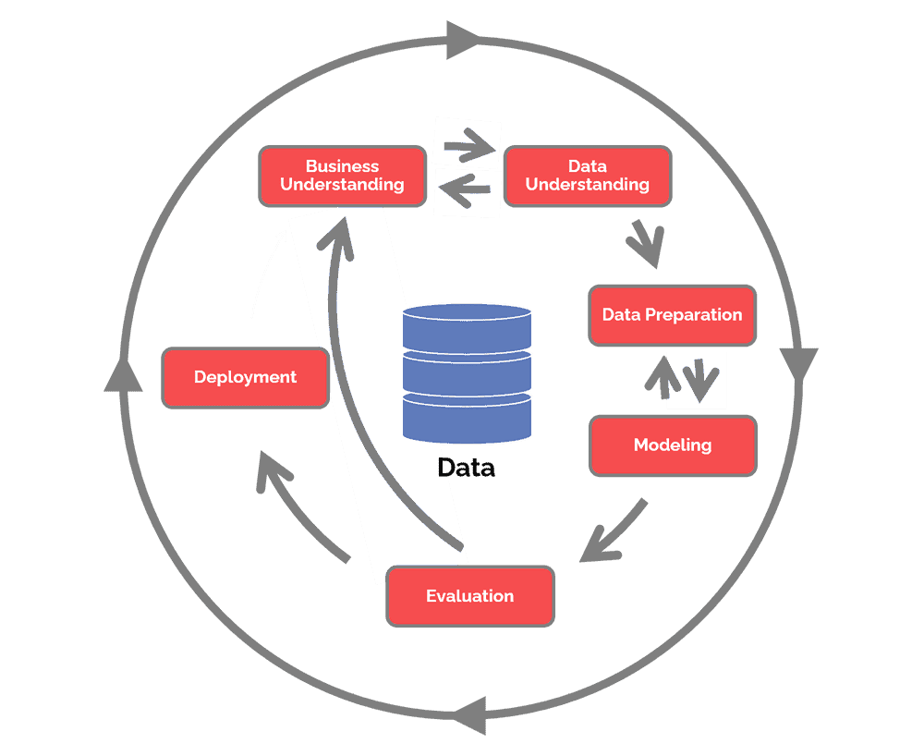
CRISP-DM
Data mining model
6-phase cyclic methodology
Business Understanding
Data Understanding
Data Preparation
Modeling
Evaluation
Deployment

Slide 7
DATA EXPLORATION

Slide 8
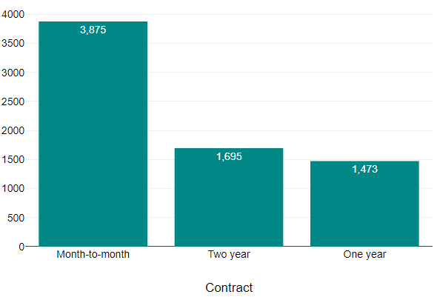
Visualisation # 1

Slide 9
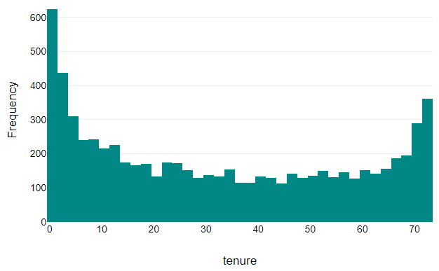
Visualisation # 2

Slide 10
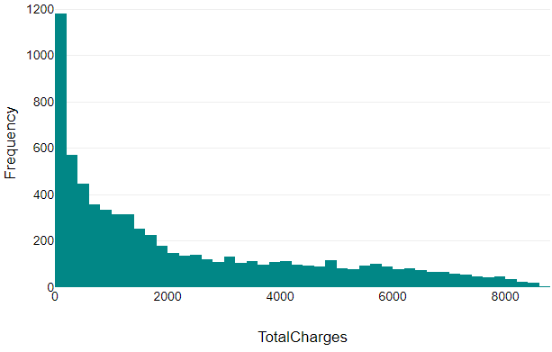
Visualisation # 3

Slide 11
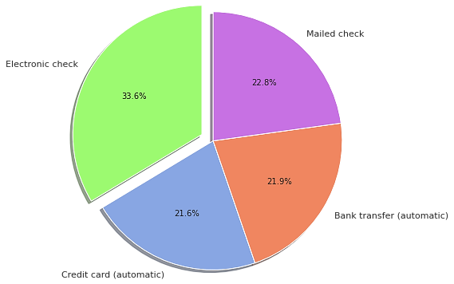
Visualisation # 4

Slide 12
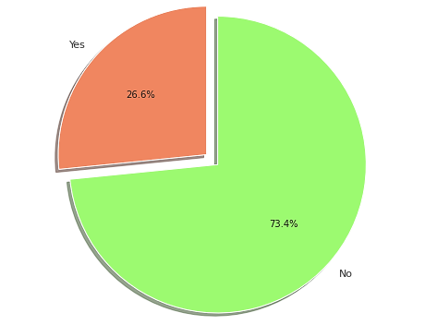
Visualisation # 5

Slide 13
Data preparation

Slide 14
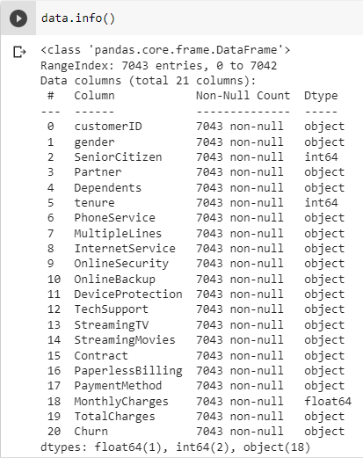
Dataset
7043 rows and 21 columns
3 numerical and 18 categorical variables
Telco Customer Churn. (n.d.).

Slide 15

Data Preparation
Prepare data for training purposes
Steps
Removing missing values
Remove empty cells
Dropping duplicates
Drop irrelevant columns
Encoding categorical data
Remove class imbalance

Slide 16

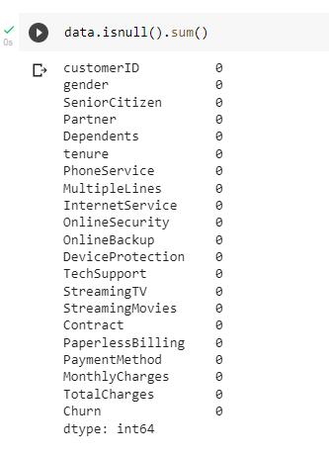
Remove missing values
No missing values exist

Slide 17
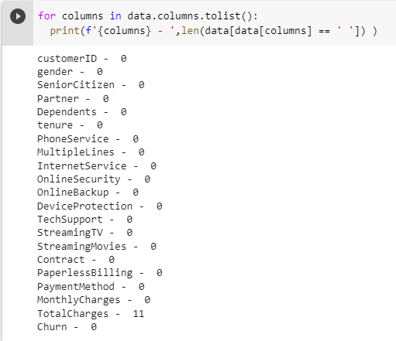
Remove empty cells
11 blank cells in Total Charges

Slide 18

Dropping duplicates
22 duplicates are removed.

Slide 19

Drop irrelevant columns
Customer ID is dropped

Slide 20
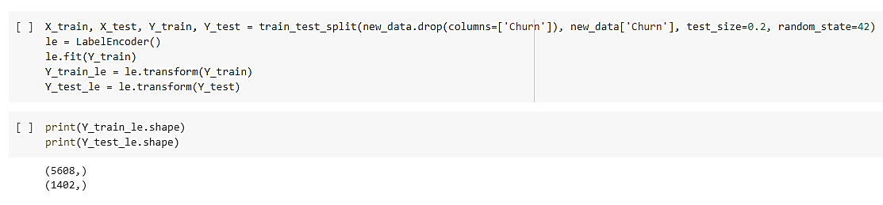
Encoding categorical data
Using one hot encoder and column transformer

Slide 21
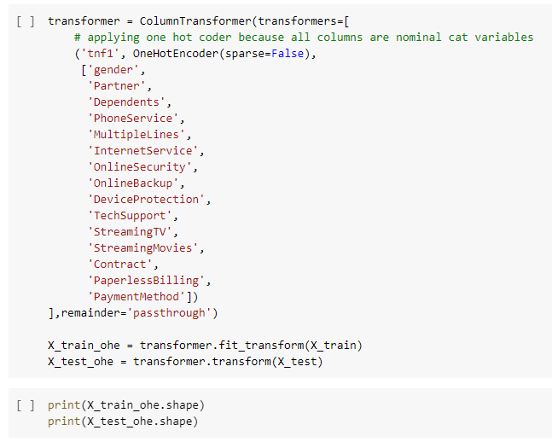
Encoding categorical data

Slide 22
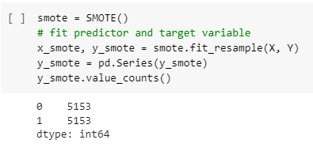
Remove class imbalance

Slide 23
Modeling

Slide 24

Random Forest
85.8% accuracy
86.4% after hyperparameter optimization
 | True Positive | False Positive
True Negative | 1358 | 171
False Negative | 285 | 1278

Slide 25
Gradient Boosted Trees
86.5% accuracy
86.91% accuracy after hyperparameter optimization
 | True Positive | False Positive
True Negative | 1311 | 194
False Negative | 223 | 1364

Slide 26
XGBoost
86.8% accuracy
86.2% accuracy after hyperparameter optimization
 | True Positive | False Positive
True Negative | 1370 | 192
False Negative | 204 | 1326

Slide 27
Summary
Sr. | Model | Base Accuracy | Accuracy after optimization | Difference
1 | Random Forest | 85.8% | 86.4% | 0.6%
2 | Gradient Boosted Trees | 86.5% | 86.9% | 0.4%
3 | XGBoost | 86.8% | 86.2% | - 0.6%

Slide 28
CONCLUSION

Slide 29
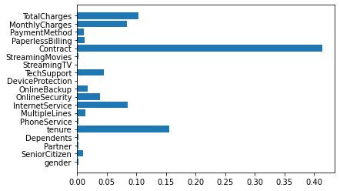
Conclusion
Important features
Contract
Tenure
Total Charges
Future work
Hyperparameter tuning
Real time data

Slide 30
References
Edwine, N., Wang, W., Song, W., & Ssebuggwawo, D. (2022). Detecting the Risk of Customer Churn in Telecom Sector: A Comparative Study. Mathematical Problems in Engineering, 2022, 1–16. https://doi.org/10.1155/2022/8534739
Wagh, S. K., & Wagh, K. S. (2022). Customer Churn Prediction in Telecom Sector Using Machine Learning Techniques. SSRN Electronic Journal. https://doi.org/10.2139/ssrn.4158415
Ly, T. V., & Son, D. V. T. (2022). Churn prediction in telecommunication industry using kernel Support Vector Machines. PloS one, 17(5), e0267935.
Jain , H. ., Khunteta, A. ., & Srivastava, S. . (2022). Telecom Churn Prediction Using an Ensemble Approach with Feature Engineering and Importance. International Journal of Intelligent Systems and Applications in Engineering, 10(3), 22–33. Retrieved from https://ijisae.org/index.php/IJISAE/article/view/2134
Zhang, T., Moro, S., & Ramos, R. F. (2022). A Data-Driven Approach to Improve Customer Churn Prediction Based on Telecom Customer Segmentation. Future Internet, 14(3), 94. https://doi.org/10.3390/fi14030094
Telco Customer Churn. (n.d.). Www.kaggle.com. Retrieved November 2, 2022, from https://www.kaggle.com/datasets/blastchar/telco-customer-churn?resource=download

